Slide 1
The Market Forces of Supply and Demand
CHAPTER 4
Notes:
N. Gregory Mankiw Principles Of Economics Eight Edition

Slide 2
Markets and Competition, Part 1
Supply and demand
Words economists use most often
The forces that make market economies work
Refer to the behavior of people as they interact with one another in competitive markets

Slide 3
Markets and Competition, Part 2
Market
A group of buyers and sellers of a particular good or service
Buyers as a group
Determine the demand for the product
Sellers as a group
Determine the supply of the product

Slide 4
Markets and Competition, Part 3
Markets take many forms
Highly organized
Markets for many agricultural commodities
Less organized
Market for ice cream in a particular town

Slide 5
Markets and Competition, Part 4
Competitive market
Market in which there are many buyers and many sellers
Each has a negligible impact on market price
Price and quantity are determined by all buyers and sellers
As they interact in the marketplace

Slide 6
Markets and Competition, Part 5
Perfectly competitive market
Goods offered for sale are all exactly the same
Buyers and sellers are so numerous
No single buyer or seller has any influence over the market price
Price takers
At the market price
Buyers can buy all they want
Sellers can sell all they want

Slide 7
Markets and Competition, Part 6
Monopoly
The only seller in the market
Sets the price
Other markets
Between perfect competition and monopoly

Slide 8
Demand, Part 1
Quantity demanded
Amount of a good that buyers are willing and able to purchase
Law of demand
Other things equal
When the price of a good rises, the quantity demanded of the good falls
When the price falls, the quantity demanded rises

Slide 9
Demand, Part 2
Demand
Relationship between the price of a good and quantity demanded
Demand schedule: a table
Demand curve: a graph
Price on the vertical axis
Quantity on the horizontal axis
Individual demand
An individual’s demand for a product

Slide 10
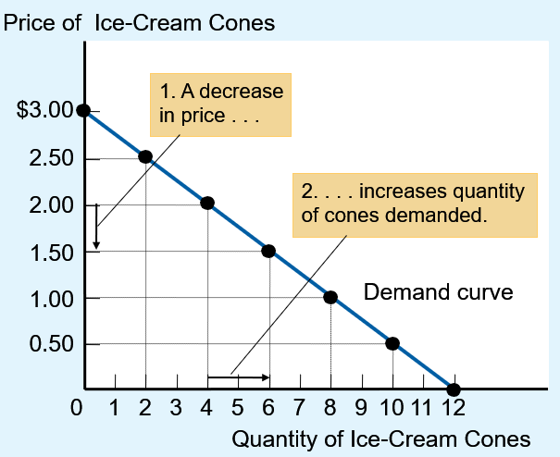
Figure 1 Catherine’s Demand Schedule and Demand Curve
Price of Ice-Cream Cone | Quantity of Cones Demanded
$0.00 0.50 1.00 1.50 2.00 2.50 3.00 | 12 cones 10 8 6 4 2 0
The demand schedule is a table that shows the quantity demanded at each price.
The demand curve, which graphs the demand schedule, illustrates how the quantity demanded of the good changes as its price varies. Because a lower price increases the quantity demanded, the demand curve slopes downward.

Slide 11
Demand, Part 3
Market demand
Sum of all individual demands for a good or service
Market demand curve
Sum the individual demand curves horizontally
Total quantity demanded of a good varies
As the price of the good varies
Other things constant

Slide 12
Figure 2 Market Demand as the Sum of Individual Demands, Part 1
Price of Ice-Cream Cone | Catherine | Nicholas | Market
0.00 dollar | 12 | 7 | 19 cones
0.5 dollar | 10 | 6 | 16 cones
1.00 dollar | 8 | 5 | 13 cones
1.50 dollars | 6 | 4 | 10 cones
2.00 dollars | 4 | 3 | 7 cones
2.50 dollars | 2 | 2 | 4 cones
3.00 dollars | 0 | 1 | 1 cone
The quantity demanded in a market is the sum of the quantities demanded by all the buyers at each price. Thus, the market demand curve is found by adding horizontally the individual demand curves. At a price of $2.00, Catherine demands 4 ice-cream cones and Nicholas demands 3 ice-cream cones. The quantity demanded in the market at this price is 7 cones.

Slide 13
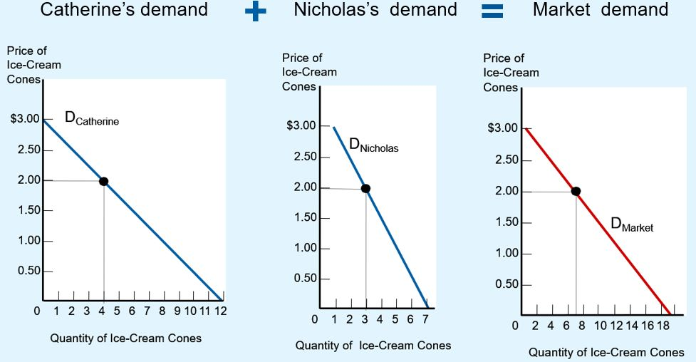
Figure 2 Market Demand as the Sum of Individual Demands, Part 2

Slide 14
Demand, Part 4
Shifts in the demand curve
Increase in demand
Any change that increases the quantity demanded at every price
Demand curve shifts right
Decrease in demand
Any change that decreases the quantity demanded at every price
Demand curve shifts left

Slide 15
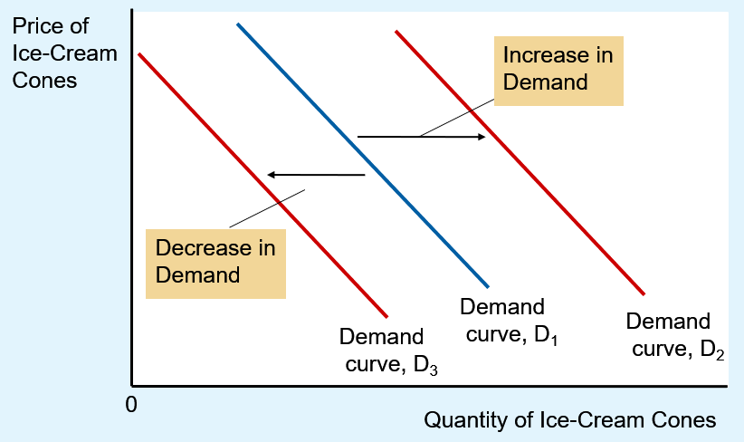
Figure 3 Shifts in the Demand Curve
Any change that raises the quantity that buyers wish to purchase at any given price shifts the demand curve to the right.
Any change that lowers the quantity that buyers wish to purchase at any given price shifts the demand curve to the left.

Slide 16
Demand, Part 5
Variables that can shift the demand curve
Income
Prices of related goods
Tastes
Expectations
Number of buyers

Slide 17
Demand, Part 6
Income
Normal good
Other things constant
An increase in income leads to an increase in demand
Inferior good
Other things constant
An increase in income leads to a decrease in demand

Slide 18
Demand, Part 7
Prices of related goods
Substitutes, two goods
An increase in the price of one
Leads to an increase in the demand for the other
Complements, two goods
An increase in the price of one
Leads to a decrease in the demand for the other

Slide 19
Demand, Part 8
Tastes
Change in tastes: changes the demand
Expectations about the future
Expect an increase in income
Increase in current demand
Expect higher prices
Increase in current demand
Number of buyers, increases
Market demand increases

Slide 20
Table 1 Variables That Influence Buyers
Variable | A change in this variable
Price of the good itself | Represents a movement along the demand curve
Income | Shifts the demand curve
Prices of related goods | Shifts the demand curve
Tastes | Shifts the demand curve
Expectations | Shifts the demand curve
Number of buyers | Shifts the demand curve
This table lists the variables that affect how much of any good consumers choose to buy.
Notice the special role that the price of the good plays: A change in the good’s price represents a movement along the demand curve, whereas a change in one of the other variables shifts the demand curve.

Slide 21

Two ways to reduce the quantity of smoking demanded, Part 1
Shift the demand curve for cigarettes and other tobacco products
Try to raise the price of cigarettes
“What is the best way to
stop this?”

Slide 22
Two ways to reduce the quantity of smoking demanded, Part 2
Shift the demand curve for cigarettes and other tobacco products
Public service announcements
Mandatory health warnings on cigarette packages
Prohibition of cigarette advertising on television
If successful
Shift demand curve to the left

Slide 23
Two ways to reduce the quantity of smoking demanded, Part 3
Try to raise the price of cigarettes
Tax the manufacturer: higher price
Movement along demand curve
10% ↑ in price → 4% ↓ in smoking
Teenagers: 10% ↑ in price → 12% ↓ in smoking
Demand for cigarettes vs. demand for marijuana
Appear to be complements

Slide 24
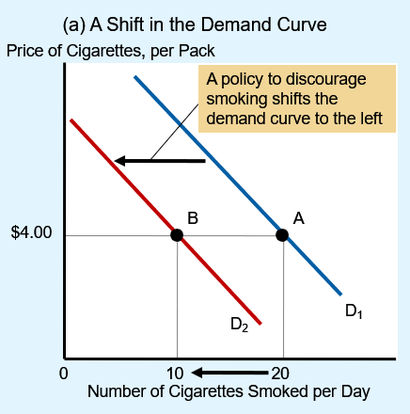
Figure 4 Shifts in the Demand Curve versus Movements along the Demand Curve (a)
If warnings on cigarette packages convince smokers to smoke less, the demand curve for cigarettes shifts to the left.
In panel (a), the demand curve shifts from D₁ to D₂.
At a price of $4.00 per pack, the quantity demanded falls from 20 to 10 cigarettes per day, as reflected by the shift from point A to point B.

Slide 25
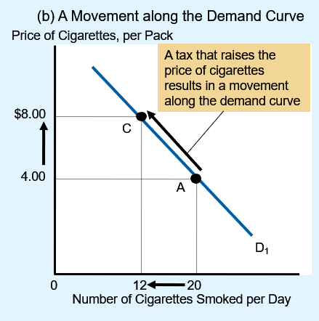
Figure 4 Shifts in the Demand Curve versus Movements along the Demand Curve (b)
By contrast, if a tax raises the price of cigarettes, the demand curve does not shift.
Instead, we observe a movement to a different point on the demand curve.
In panel (b), when the price rises from $4.00 to $8.00, the quantity demanded falls from 20 to 12 cigarettes per day, as reflected by the movement from point A to point C.

Slide 26
Supply, Part 1
Quantity supplied
Amount of a good
Sellers are willing and able to sell
Law of supply
Other things equal
When the price of a good rises, the quantity supplied of the good also rises
When the price falls, the quantity supplied falls as well

Slide 27
Supply, Part 2
Supply
Relationship between the price of a good and the quantity supplied
Supply schedule: a table
Supply curve: a graph
Price on the vertical axis
Quantity on the horizontal axis
Individual supply
A seller’s individual supply

Slide 28
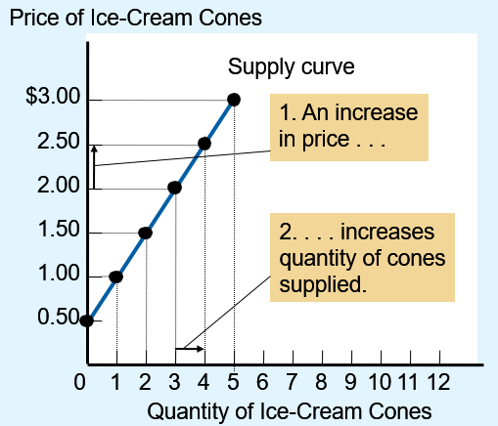
Figure 5 Ben’s Supply Schedule and Supply Curve
Price of Ice-cream Cone | Quantity Of Cones Supplied
$0.00 0.50 1.00 1.50 2.00 2.50 3.00 | 0 cones 0 1 2 3 4 5
The supply schedule is a table that shows the quantity supplied at each price.
This supply curve, which graphs the supply schedule, illustrates how the quantity supplied of the good changes as its price varies.
Because a higher price increases the quantity supplied, the supply curve slopes upward.

Slide 29
Supply, Part 3
Market supply
Sum of the supplies of all sellers for a good or service
Market supply curve
Sum of individual supply curves horizontally
Total quantity supplied of a good varies
As the price of the good varies
All other factors that affect how much suppliers want to sell are hold constant

Slide 30
Figure 6 Market Supply as the Sum of Individual Supplies, Part 1
Price of ice-cream cone | Ben | Jerry | Market
0.00 dollar | 0 | 0 | 0 cone
0.50 dollar | 0 | 0 | 0 cone
1.00 dollar | 1 | 0 | 1 cone
1.50 dollars | 2 | 2 | 4 cones
2.00 dollars | 3 | 4 | 7 cones
2.50 dollars | 4 | 6 | 10 cones
3.00 dollars | 5 | 8 | 13 cones
The quantity supplied in a market is the sum of the quantities supplied by all the sellers at each price. Thus, the market supply curve is found by adding horizontally the individual supply curves. At a price of $2.00, Ben supplies 3 ice-cream cones and Jerry supplies 4 ice-cream cones. The quantity supplied in the market at this price is 7 cones.

Slide 31
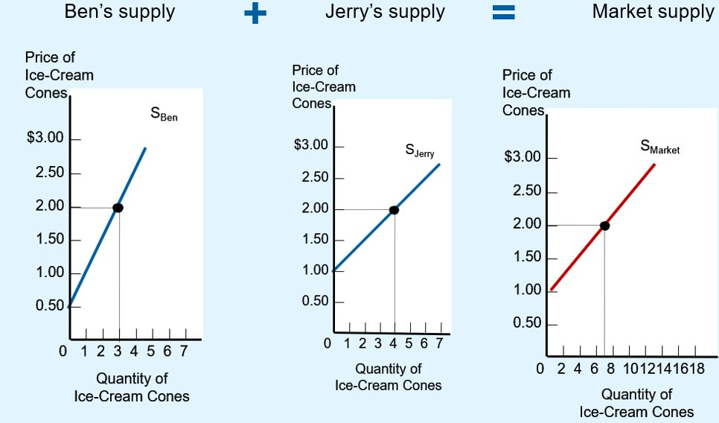
Figure 6 Market Supply as the Sum of Individual Supplies, Part 2

Slide 32
Supply, Part 4
Shifts in supply
Increase in supply
Any change that increases the quantity supplied at every price
Supply curve shifts right
Decrease in supply
Any change that decreases the quantity supplied at every price
Supply curve shifts left

Slide 33
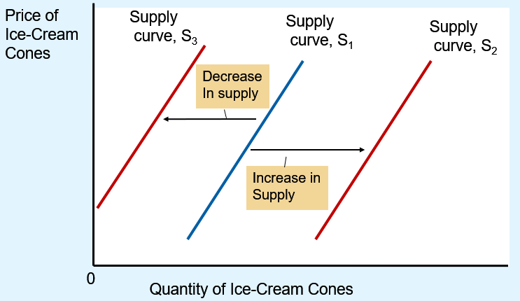
Exhibit 7 Shifts in the Supply Curve
Any change that raises the quantity that sellers wish to produce at any given price shifts the supply curve to the right.
Any change that lowers the quantity that sellers wish to produce at any given price shifts the supply curve to the left.

Slide 34
Supply, Part 5
Variables that can shift the supply curve
Input prices
Technology
Expectations about future
Number of sellers

Slide 35
Supply, Part 6
Input prices
Supply is negatively related to prices of inputs
Higher input prices: decrease in supply
Technology
Advance in technology: reduces firms’ costs: increase in supply

Slide 36
Supply, Part 7
Expectations about future
Affect current supply
Expected higher prices
Decrease in current supply
Number of sellers, increases
Market supply increases

Slide 37
Table 2 Variables That Influence Sellers
Variable | A change in this variable
Price of the good itself | Represents a movement along the supply curve
Input prices | Shifts the supply curve
Technology | Shifts the supply curve
Expectations | Shifts the supply curve
Number of sellers | Shifts the supply curve
This table lists the variables that affect how much of any good producers choose to sell.
Notice the special role that the price of the good plays: A change in the good’s price represents a movement along the supply curve, whereas a change in one of the other variables shifts the supply curve.

Slide 38
Supply and Demand Together, Part 1
Equilibrium
Various forces are in balance
A situation in which market price has reached the level where
Quantity supplied = Quantity demanded
Supply and demand curves intersect

Slide 39
Supply and Demand Together, Part 2
Equilibrium price
Balances quantity supplied and quantity demanded
Market-clearing price
Equilibrium quantity
Quantity supplied and quantity demanded at the equilibrium price

Slide 40
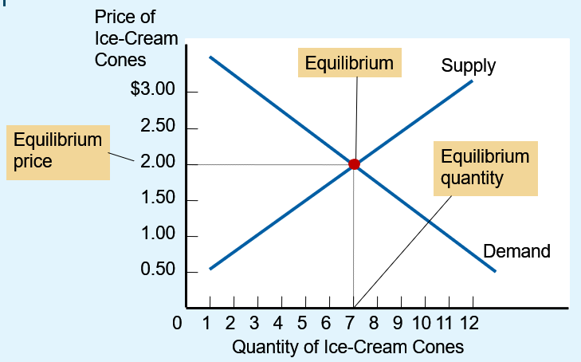
Figure 8 The Equilibrium of Supply and Demand
The equilibrium is found where the supply and demand curves intersect. At the equilibrium price, the quantity supplied equals the quantity demanded.
Here the equilibrium price is $2.00: At this price, 7 ice-cream cones are supplied and 7 ice-cream cones are demanded.

Slide 41
Supply and Demand Together, Part 3
Surplus
Quantity supplied > Quantity demanded
Excess supply
Downward pressure on price
Movements along the demand and supply curves
Increase in quantity demanded
Decrease in quantity supplied

Slide 42
Supply and Demand Together, Part 4
Shortage
Quantity demanded > Quantity supplied
Excess demand
Upward pressure on price
Movements along the demand and supply curves
Decrease in quantity demanded
Increase in quantity supplied

Slide 43
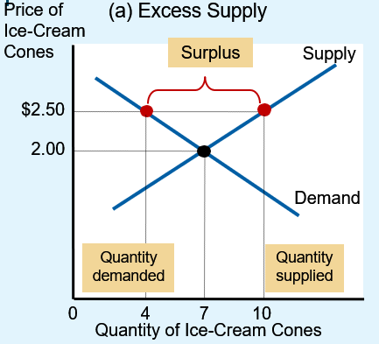
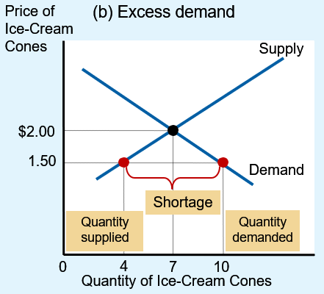
Figure 9 Markets Not in Equilibrium
In panel (a), there is a surplus. Because the market price of $2.50 is above the equilibrium price, the quantity supplied (10 cones) exceeds the quantity demanded (4 cones). Suppliers try to increase sales by cutting the price of a cone, and this moves the price toward its equilibrium level.
In panel (b), there is a shortage. Because the market price of $1.50 is below the equilibrium price, the quantity demanded (10 cones) exceeds the quantity supplied (4 cones). With too many buyers chasing too few goods, suppliers can take advantage of the shortage by raising the price. Hence, in both cases, the price adjustment moves the market toward the equilibrium of supply and demand.

Slide 44
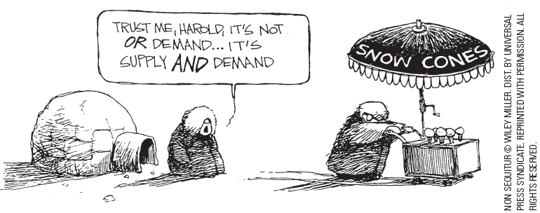
Supply and Demand Together, Part 5
Law of supply and demand
The price of any good adjusts
To bring the quantity supplied and the quantity demanded for that good into balance
In most markets
Surpluses and shortages are temporary

Slide 45
Supply and Demand Together, Part 6
Three steps to analyzing changes in equilibrium
Decide whether the event shifts the supply curve, the demand curve, or, in some cases, both curves
Decide whether the curve shifts to the right or to the left
Use the supply-and-demand diagram
Compare the initial and the new equilibrium
Effects on equilibrium price and quantity

Slide 46
Table 3 Three Steps for Analyzing Changes in Equilibrium
Decide whether the event shifts the supply or demand curve (or perhaps both).
Decide in which direction the curve shifts.
Use the supply-and demand diagram to see how the shift changes the equilibrium price and quantity.

Slide 47
Supply and Demand Together, Part 7
A change in market equilibrium due to a shift in demand
One summer, very hot weather
Effect on the market for ice cream?
Hot weather: shifts the demand curve (tastes )
Demand curve shifts to the right
Higher equilibrium price; higher equilibrium quantity

Slide 48
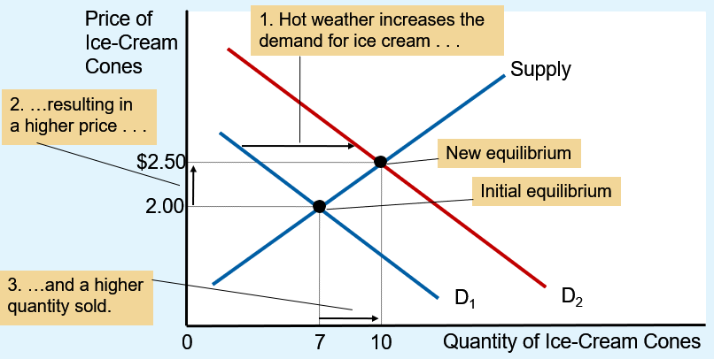
Figure 10 How an Increase in Demand Affects the Equilibrium
An event that raises quantity demanded at any given price shifts the demand curve to the right. The equilibrium price and the equilibrium quantity both rise. Here an abnormally hot summer causes buyers to demand more ice cream. The demand curve shifts from D₁ to D₂, which causes the equilibrium price to rise from $2.00 to $2.50 and the equilibrium quantity to rise from 7 to 10 cones.

Slide 49
Supply and Demand Together, Part 8
Shifts vs. movements along curves
Shift in the supply curve
Change in supply
Movement along a fixed supply curve
Change in the quantity supplied
Shift in the demand curve
Change in demand
Movement along a fixed demand curve
Change in the quantity demanded

Slide 50
Supply and Demand Together, Part 9
A change in market equilibrium due to a shift in supply
One summer, a hurricane destroys part of the sugarcane crop: higher price of sugar
Effect on the market for ice cream?
Change in price of sugar: supply curve
Supply curve: shifts to the left
Higher equilibrium price; lower equilibrium quantity

Slide 51
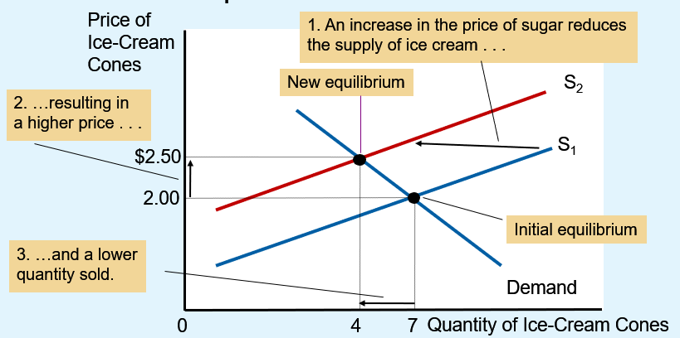
Figure 11 How a Decrease in Supply Affects the Equilibrium
An event that reduces quantity supplied at any given price shifts the supply curve to the left. The equilibrium price rises, and the equilibrium quantity falls. Here an increase in the price of sugar (an input) causes sellers to supply less ice cream. The supply curve shifts from S₁ to S₂, which causes the equilibrium price of ice cream to rise from $2.00 to $2.50 and the equilibrium quantity to fall from 7 to 4 cones.

Slide 52
Supply and Demand Together, Part 10
Shifts in both supply and demand
One summer: hurricane and heat wave
Heat wave shifts the demand curve; hurricane shifts the supply curve
Demand curve shifts to the right; Supply curve shifts to the left
Equilibrium price raises
If demand increases substantially while supply falls just a little: equilibrium quantity rises
If supply falls substantially while demand rises just a little: equilibrium quantity falls

Slide 53
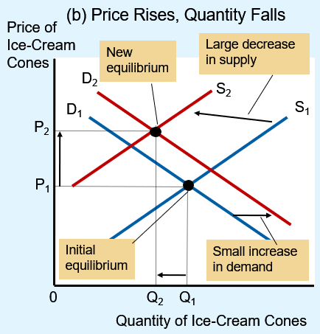
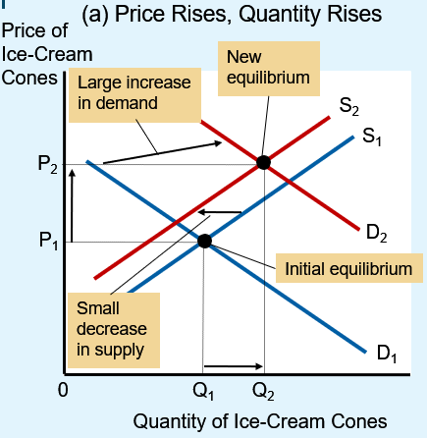
Figure 12 A Shift in Both Supply and Demand
Here we observe a simultaneous increase in demand and decrease in supply. Two outcomes are possible. In panel (a), the equilibrium price rises from P₁ to P₂, and the equilibrium quantity rises from Q₁ to Q₂.
In panel (b), the equilibrium price again rises from P1 to P2, but the equilibrium quantity falls from Q₁ to Q₂.

Slide 54
Table 4 What Happens to Price and Quantity When Supply or Demand Shifts?
Demand | No Change in Supply | An Increase in Supply | A Decrease in Supply
No Change in Demand | P same; Q same | P down; Q up | P up; Q down
An Increase in Demand | P up; Q up | P ambiguous; Q up | P up; Q ambiguous
A Decrease in Demand | P down; Q down | P down; Q ambiguous | P ambiguous; Q down
As a quick quiz, make sure you can explain at least a few of the entries in this table using a supply-and-demand diagram.

Slide 55

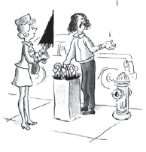
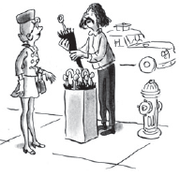
How Prices Allocate Resources, Part 1
Supply and demand together
Determine the prices of the economy’s many different goods and services
“Two dollars”
“—and seventy-five cents.”

Slide 56
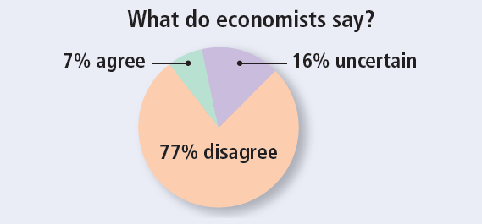
ASK THE EXPERTS
Price Gouging
“Connecticut should pass its Senate Bill 60, which states that during a ‘severe weather event emergency, no person within the chain of distribution of consumer goods and services shall sell or offer to sell consumer goods or services for a price that is unconscionably excessive.’”

Slide 57
How Prices Allocate Resources, Part 2
Prices
Signals that guide the allocation of resources
Mechanism for rationing scarce resources
Determine who produces each good and how much is produced

